Slide 1

WELCOME
COHORT 5
7th Sept – 3rd Dec 2026
Suite 6-6-7, Level 6, Menara MAA

Slide 2
Contents
JSX Deep Dive & Syntax Mastery
Functional Components & Composition

Slide 3
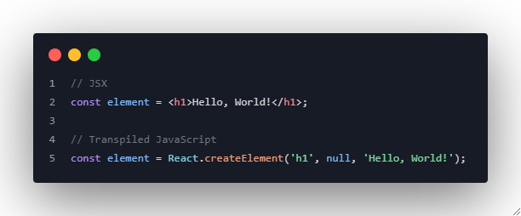
What is JSX?
JavaScript XML - Syntax extension for JavaScript
Allows writing HTML-like code in JavaScript
Makes React components more readable and intuitive

Slide 4
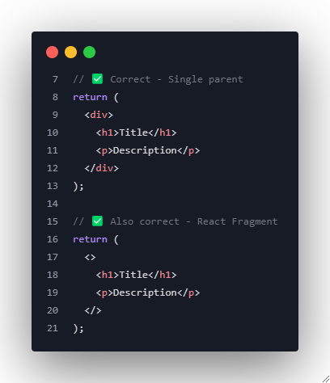
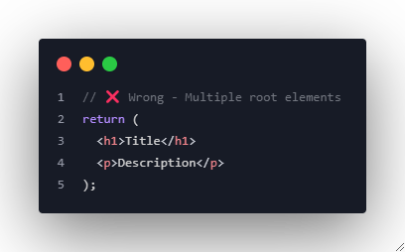
JSX Fundamental Rules
1. Single Parent Element

Slide 5
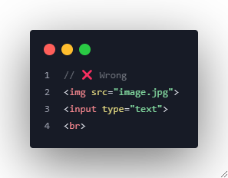
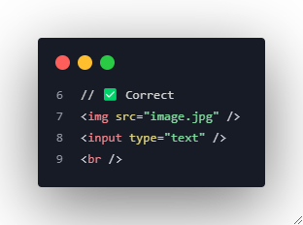
JSX Fundamental Rules
2. Self-Closing Tags

Slide 6
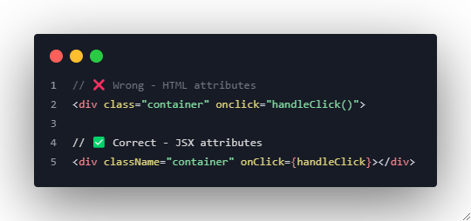
JSX Fundamental Rules
3. camelCase for Attributes

Slide 7
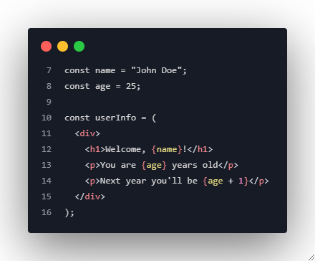
Embedding JavaScript Expressions
Basic Expression Embedding

Slide 8
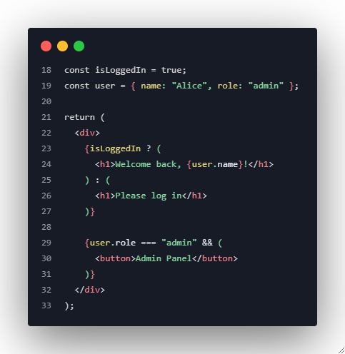
Advanced Expression Examples
Conditional Rendering

Slide 9
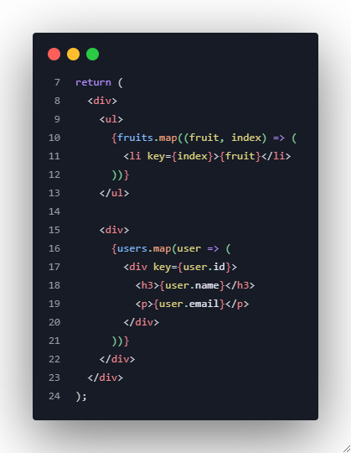
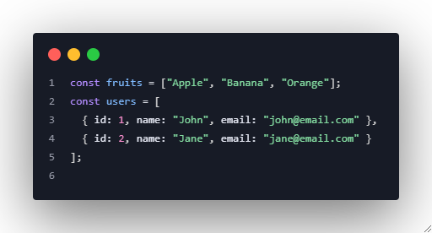
Array Rendering & Lists

Slide 10
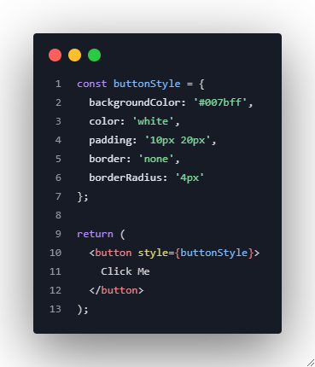
JSX Styling Approaches
Inline Styles

Slide 11
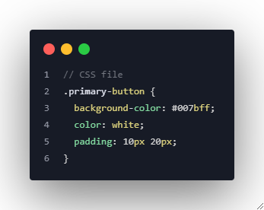
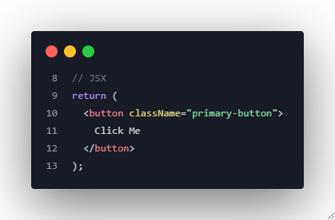
JSX Styling Approaches
CSS Classes

Slide 12
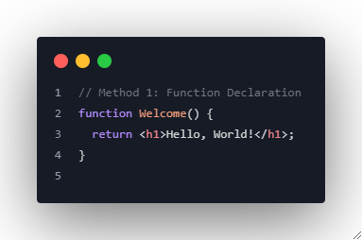
Creating Functional Components
Basic Function Component
Notes:
Most tradition JavaScript function

Slide 13
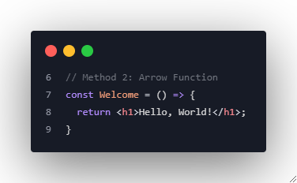
Creating Functional Components
Basic Function Component
Notes:
Can only use arrow function components after you define them
The const

Slide 14
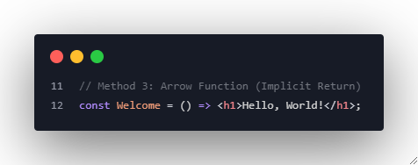
Creating Functional Components
Basic Function Component
Notes:
Arrow functions can automatically return a value without writing the “return” keyword, as long as the code <h1> is inside the bracket/parantheses ( )
When to use? When your component only returns a single piece of JSX. For example, the <h1>
For one-liners

Slide 15
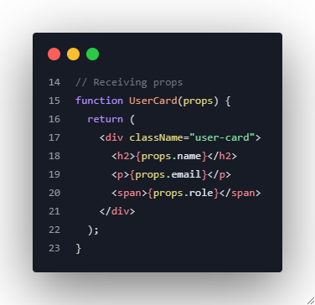
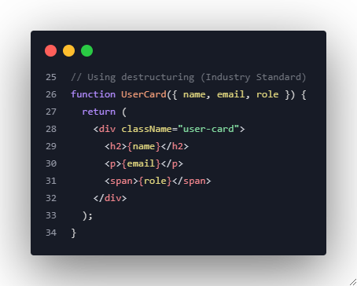
Component with Props
Notes:
UserCard is the child component
name, email and role are props
Each props is like a piece of data sent from the parent (App) to the child (UserCard)
Method 1: Receiving props is a little repetitive, but a more explicit way.
Method 2: Cleaner and modern way. Same result, just shorter and easier to read. No need to type props. every time.

Slide 16
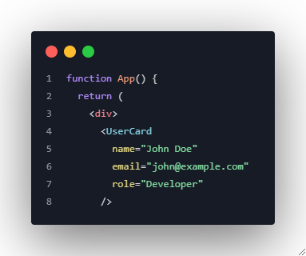
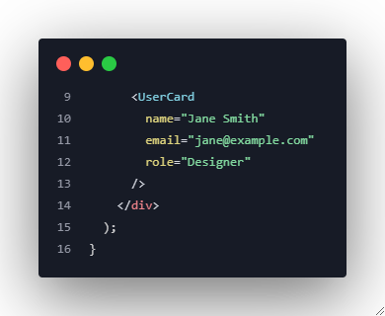
Using Components
Notes:
- This is the parent where each prop data is stored.

Slide 17
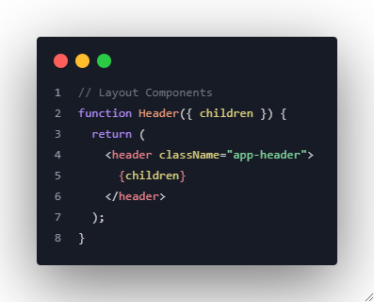
Advanced Composition: Layout Components
Notes:
All three are container components.
They don’t decide what to show, but they decide how the wrapped content is placed and styled.
Related to the <Header><Sidebar> and <MainContent> tags in page 20.

Slide 18
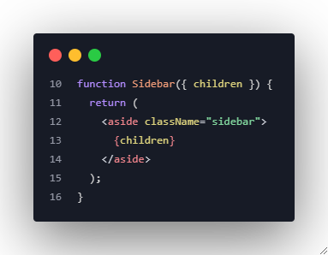
Advanced Composition: Layout Components

Slide 19
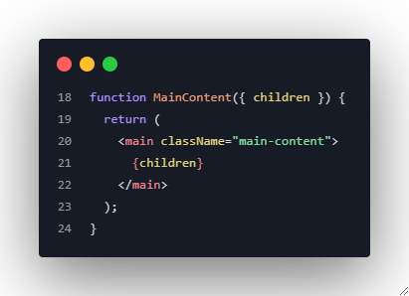
Advanced Composition: Layout Components

Slide 20
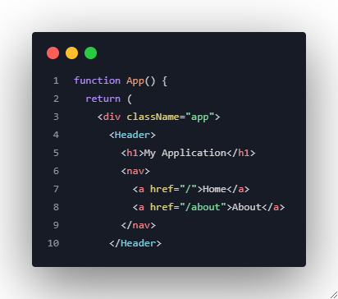
Using Layout Components

Slide 21
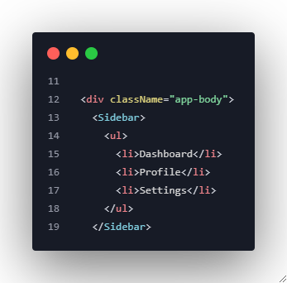
Using Layout Components

Slide 22
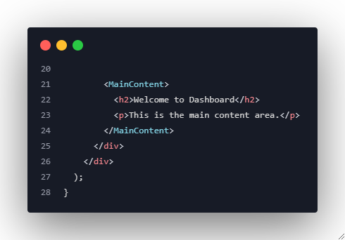
Using Layout Components

Slide 23
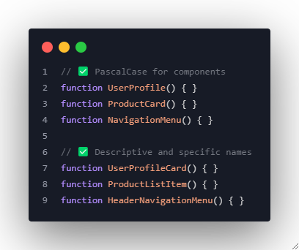
Industry-Standard Naming Conventions

Slide 24
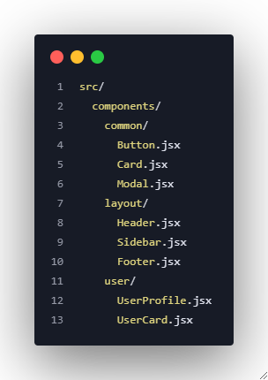
Industry-Standard Naming Conventions

Slide 25
Practice Exercise 1: Product Card Component
Create a reusable ProductCard component with:
Product image
Product name
Price
Description
Add to cart button

Slide 26
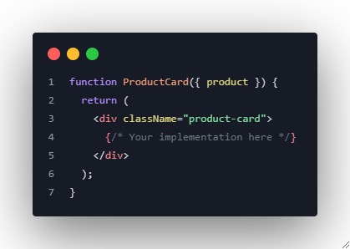
Practice Exercise 1: Product Card Component

Slide 27
Practice Exercise 2: User Dashboard
Build a user dashboard with:
Header with user name
Sidebar with navigation
Main content area with user stats
Footer with links
Use component composition principles.

Slide 28
Key Takeaways
JSX Mastery:
✅ Always wrap in single parent or Fragment
✅ Use camelCase for attributes
✅ Self-close all tags
✅ Use curly braces for JavaScript expressions

Slide 29
Key Takeaways
Component Best Practices:
✅ Use functional components as industry standard
✅ Destructure props for cleaner code
✅ Create reusable, composable components
✅ Follow PascalCase naming convention
✅ Organize components logically in folders

